Slide 1
LAB 3
Instruction Set
Datasheet
Instruction Set

Slide 2
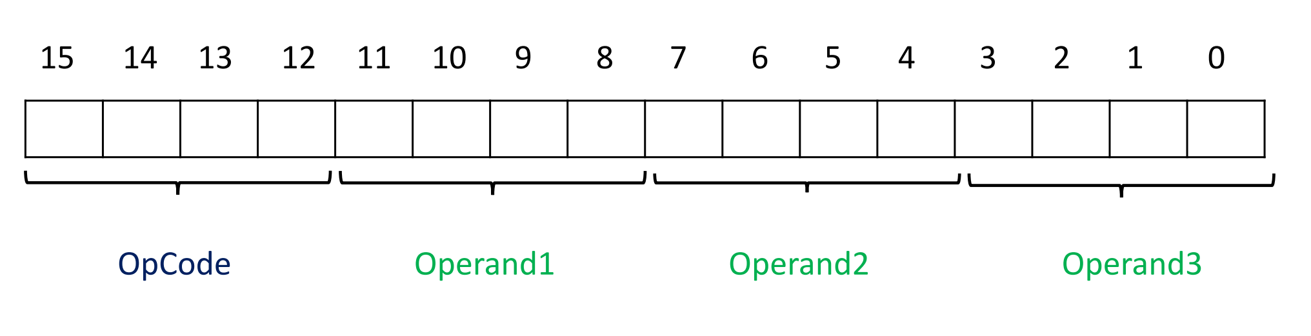
Overview
指令的架構
PIC18F4520中指令大多由1個word(2 byte)組成
每個指令可分為OpCode及Operands
Operand可以是地址、參數、常數

Slide 3
Overview Cont.
指令分類
Byte-oriented
操作的基本單元為byte，對一整個byte的操作，算術運算、邏輯運算以及skip等等
Bit-oriented
操作的基本單元為bit，對某個byte的特定bit做操作，包含clear、set、flip等等
Literal
operand由常數構成，直接用常數和register操作
Control
用於流程控制，主要為各式branch指令

Slide 4
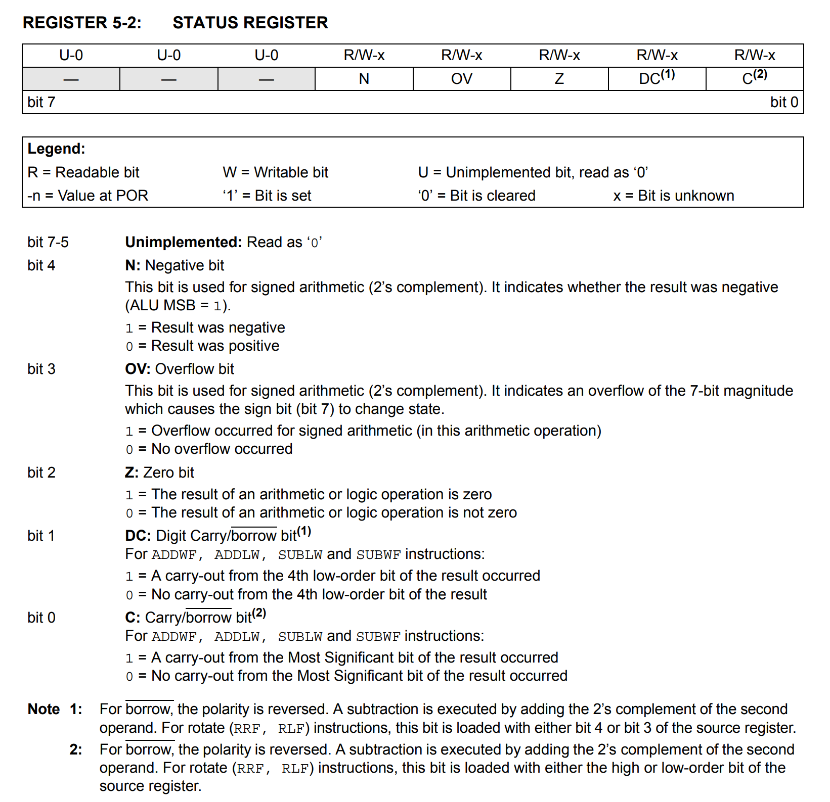
Status Register
紀錄運算後的狀態
N Negative
OV Overflow
Z Zero
DC Digit Carry 0x0F 🡪 0x10
C Carry

Slide 5
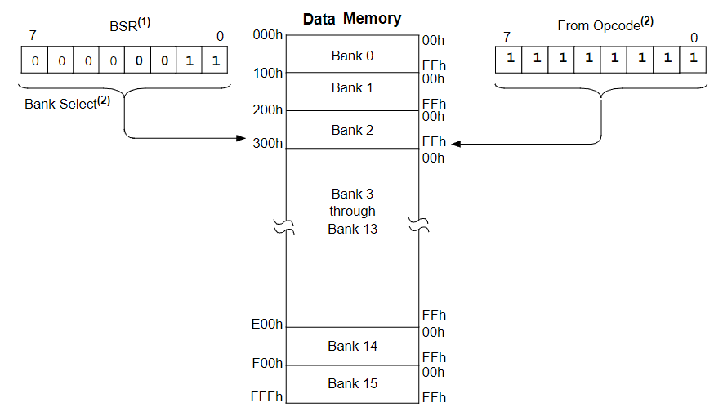
Bank Select Register (BSR)
Data Memory有12-bit
多數指令中用來定址的operand為8-bit
用BSR來紀錄bank
確定bank
確定位移量

Slide 6
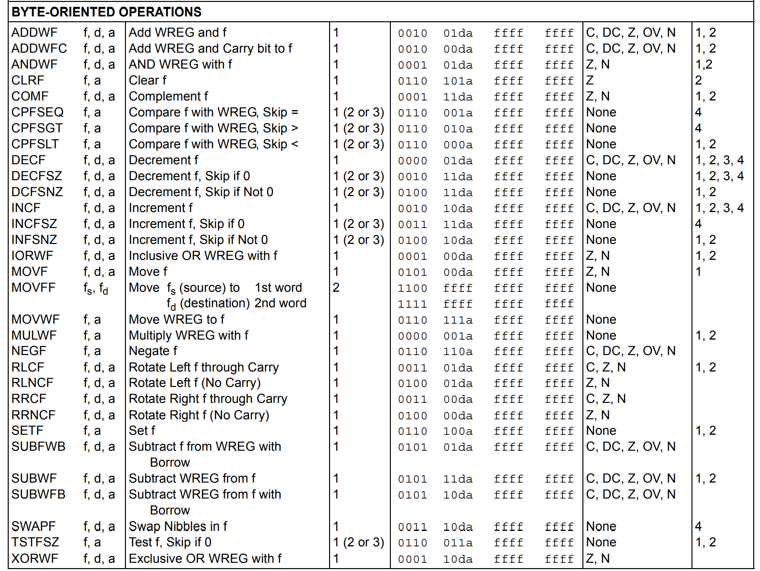
Byte-oriented operations

Slide 7
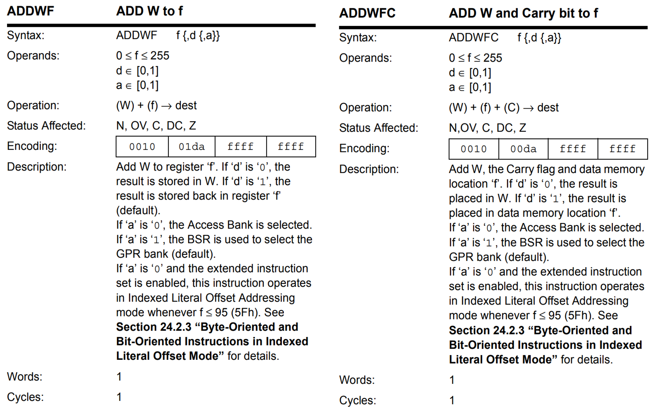
Byte-oriented operations Cont.

Slide 8
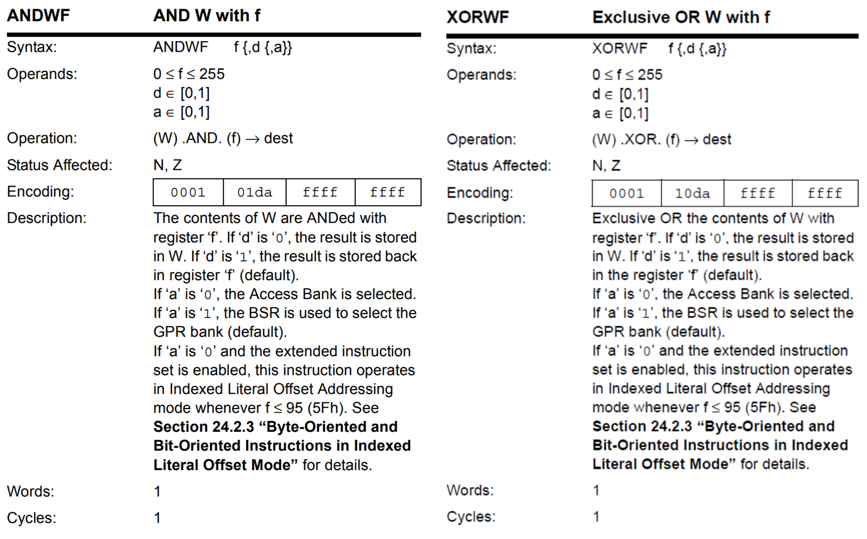
Byte-oriented operations Cont.

Slide 9
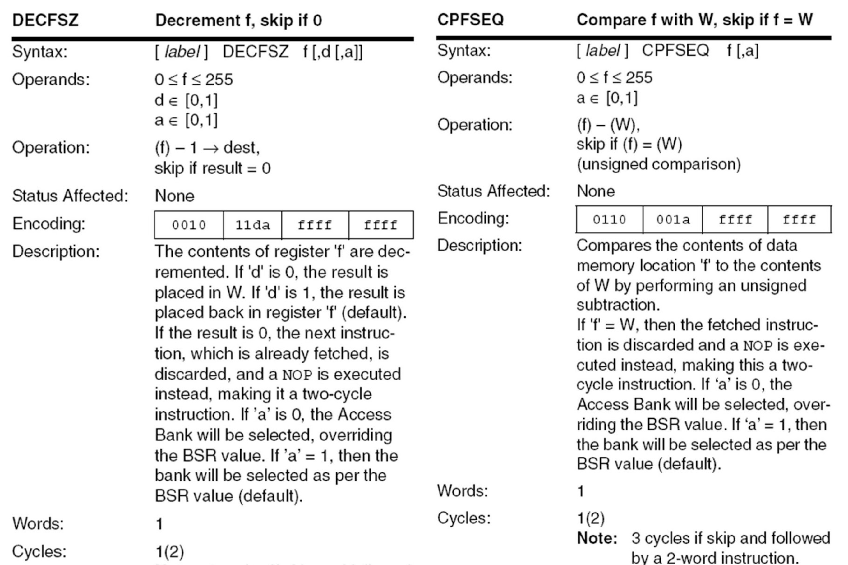
Byte-oriented operations Cont.

Slide 10
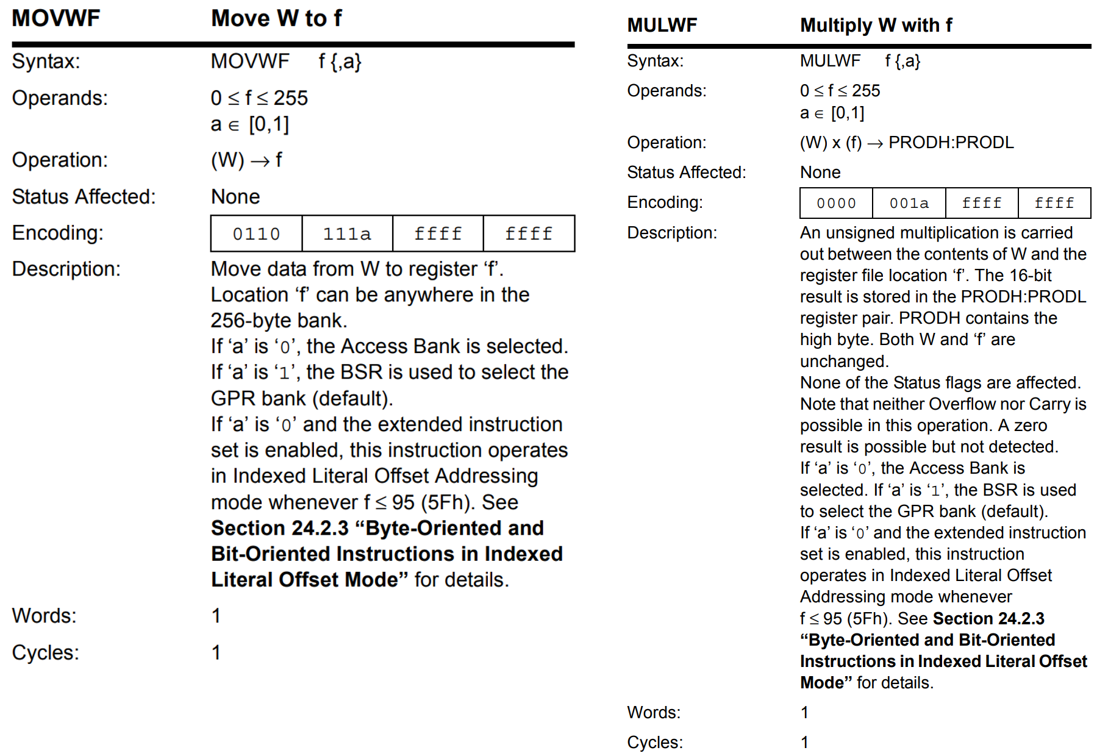
Byte-oriented operations Cont.

Slide 11
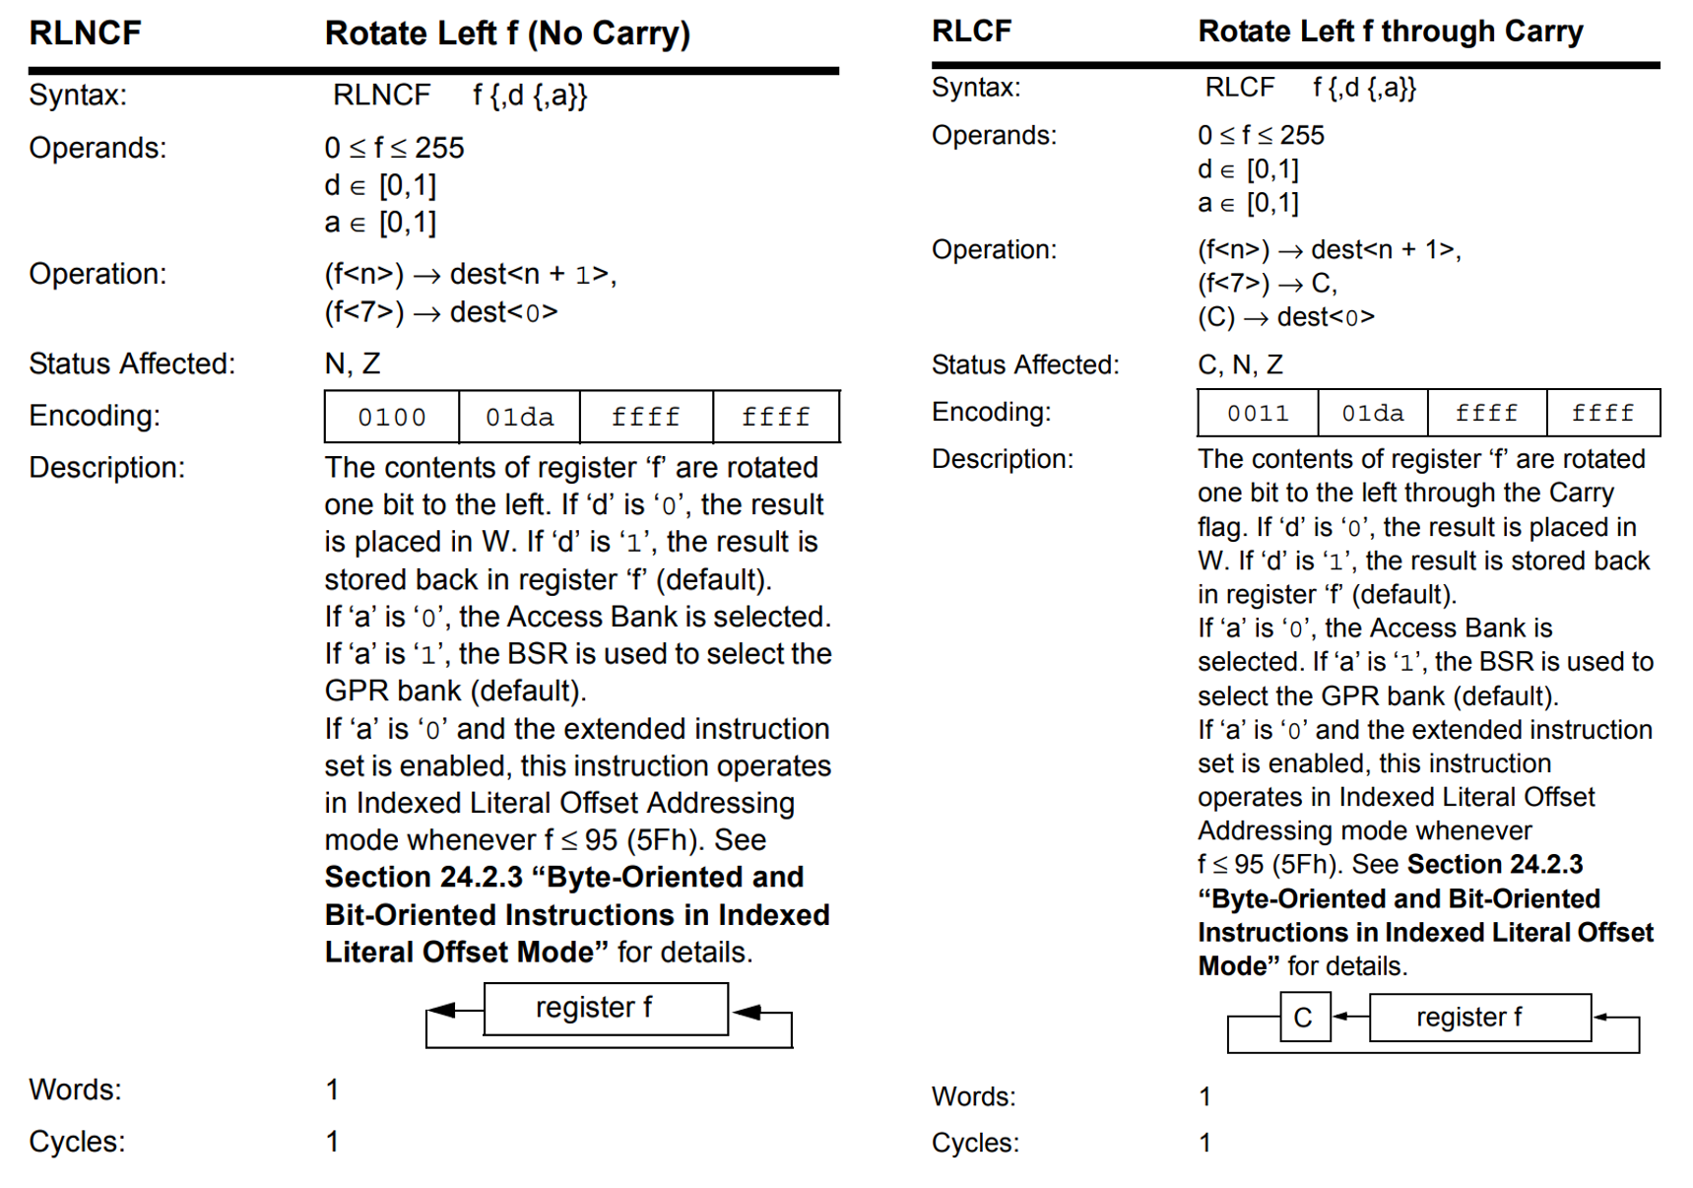
Byte-oriented operations Cont.

Slide 12
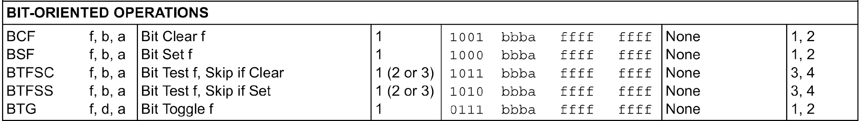
Bit-oriented operations

Slide 13
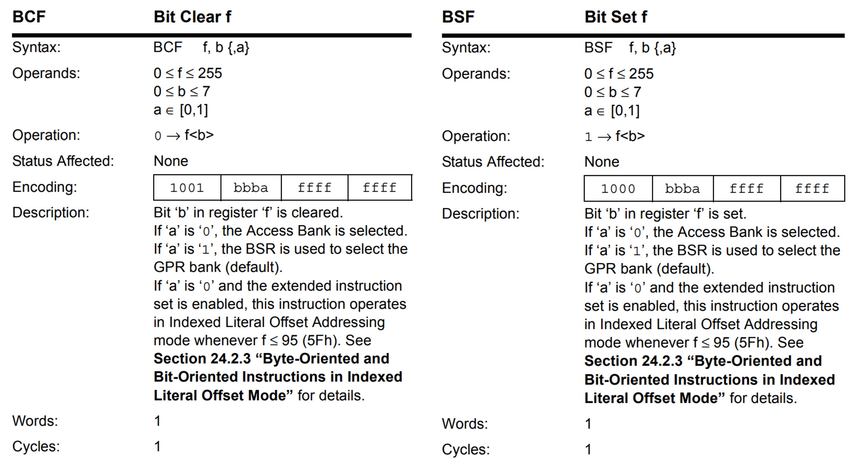
Bit-oriented operations Cont.

Slide 14
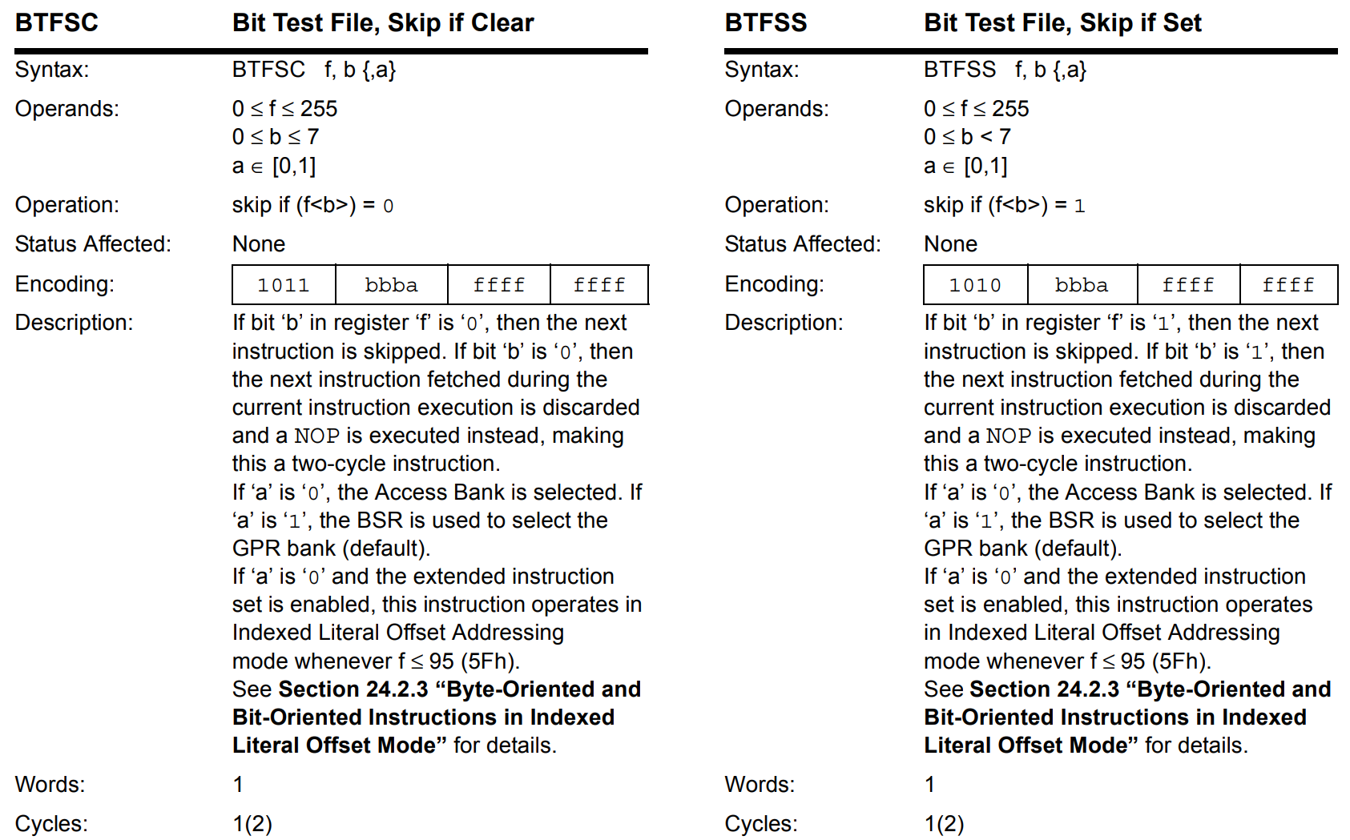
Bit-oriented operations Cont.

Slide 15
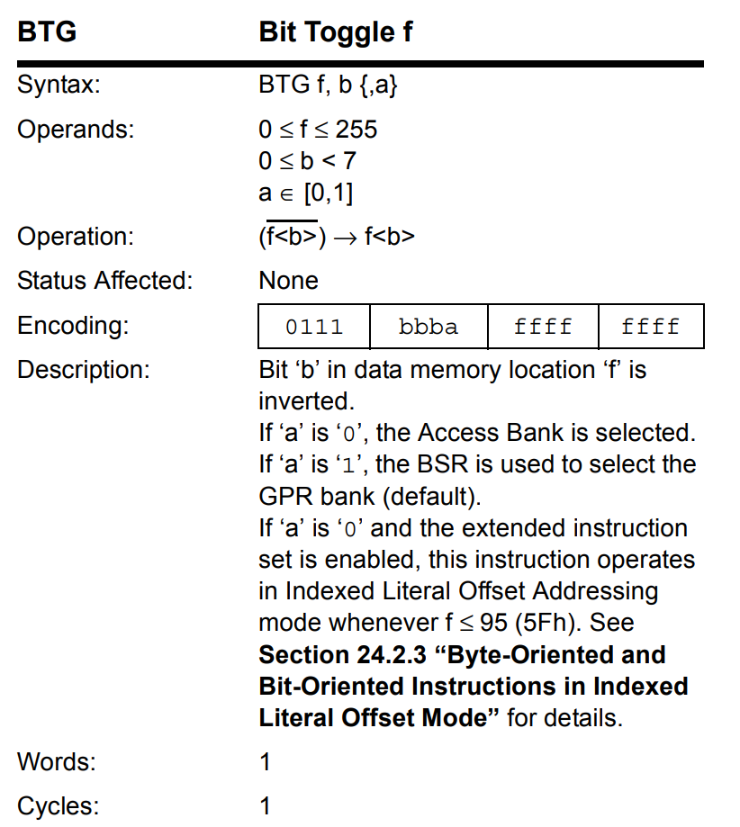
Bit-oriented operations Cont.

Slide 16
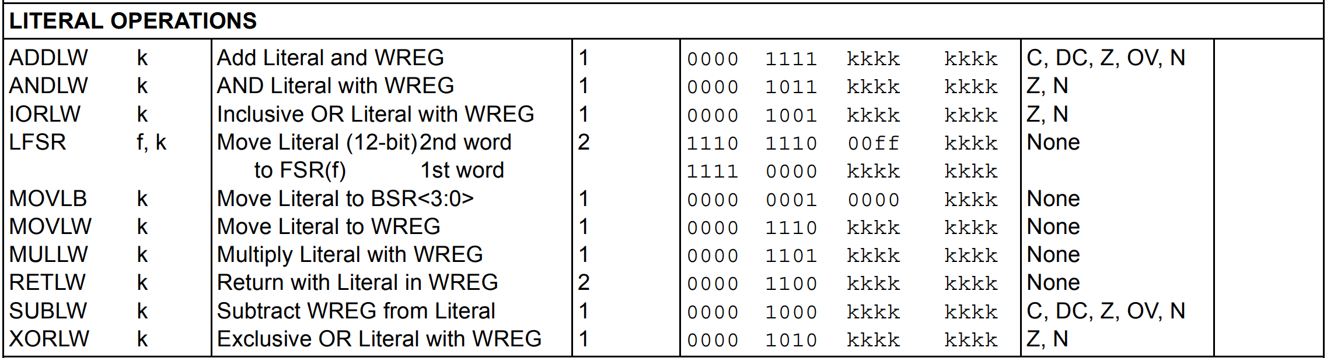
Literal operations

Slide 17
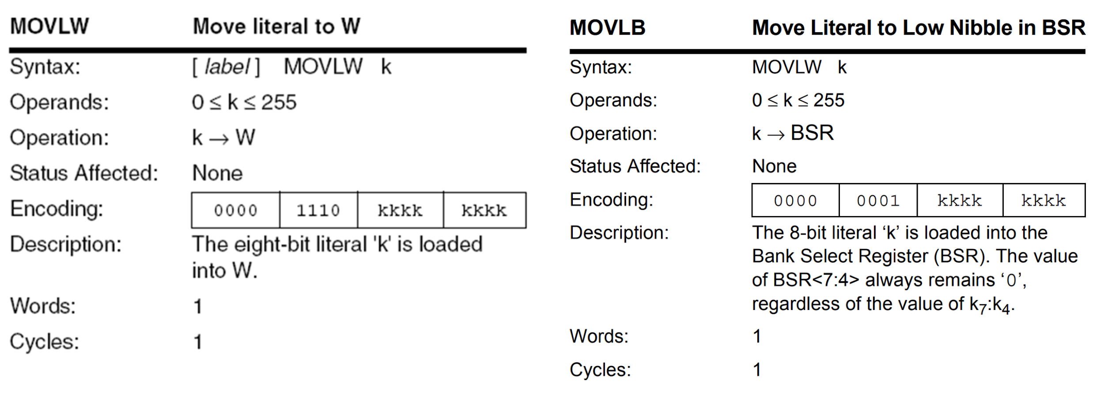
Literal operations Cont.

Slide 18
Literal operations Cont.
ADDLW Add Literal and WREG
ANDLW AND Literal with WREG
IORLW Inclusive OR Literal with WREG
LFSR Move Literal (12-bit) 2nd word to FSR(f) 1st word
MULLW Multiply Literal with WREG
SUBLW Subtract WREG from Literal
XORLW Exclusive OR Literal with WREG

Slide 19
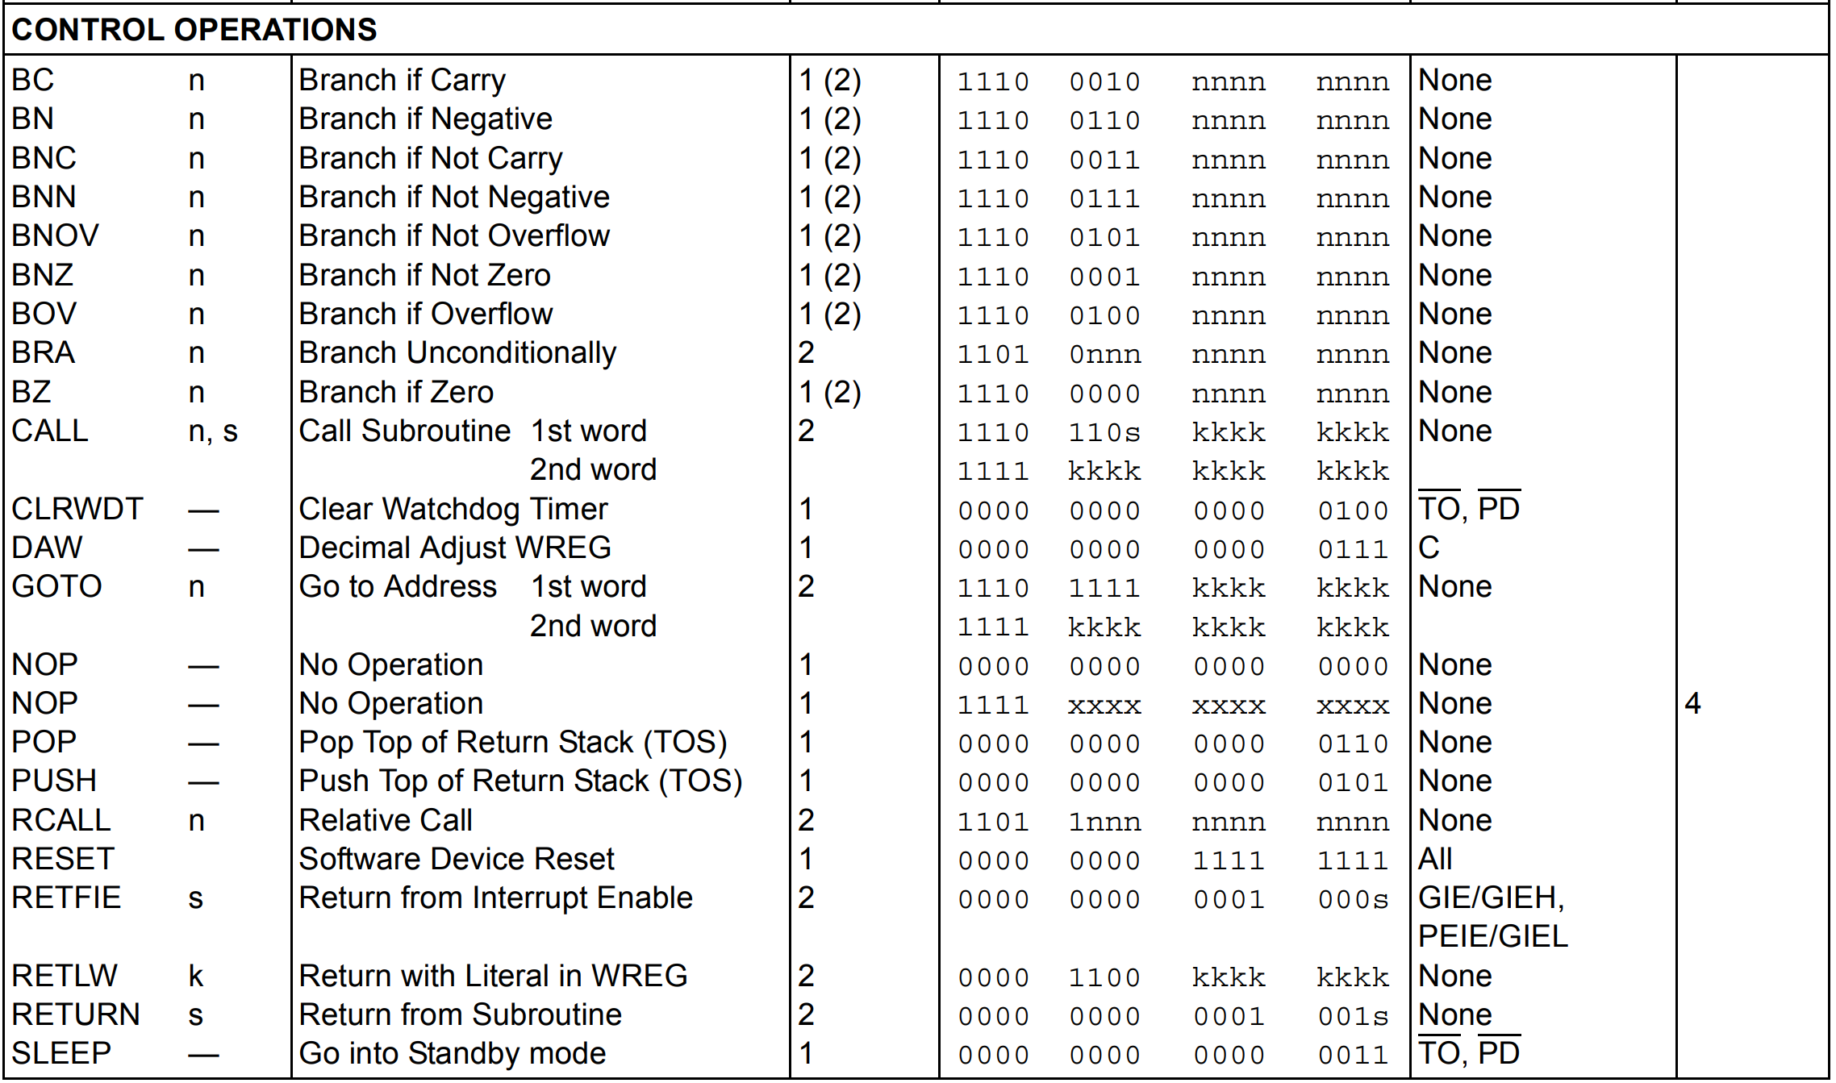
Control operations

Slide 20
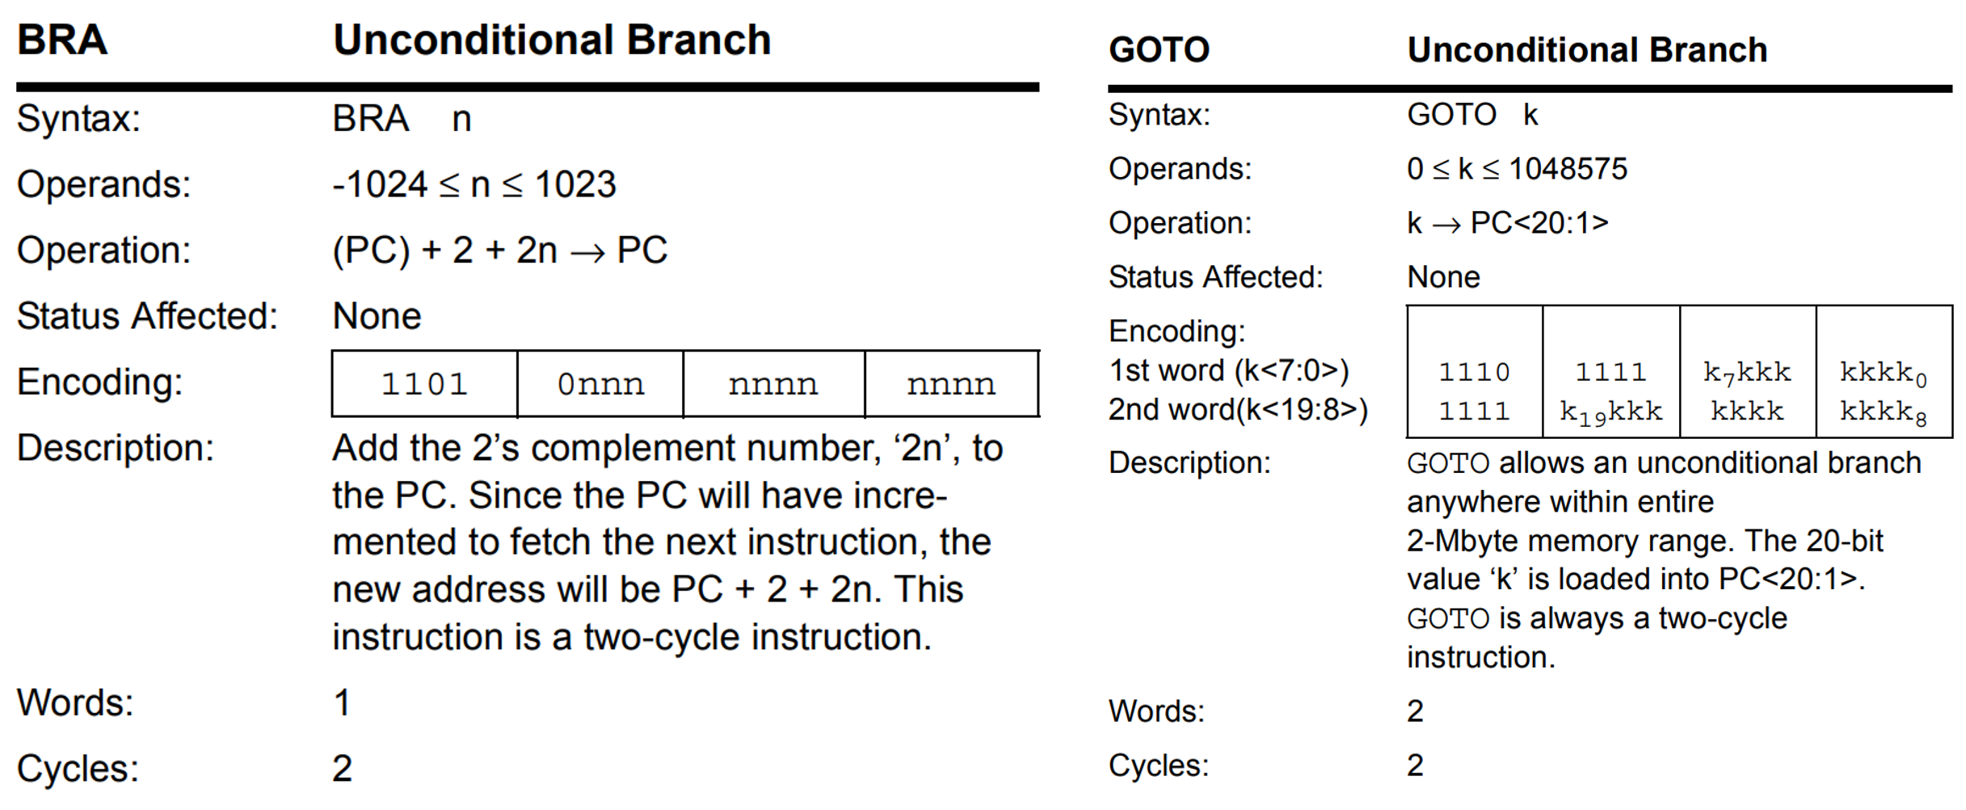
Control operations Cont.

Slide 21
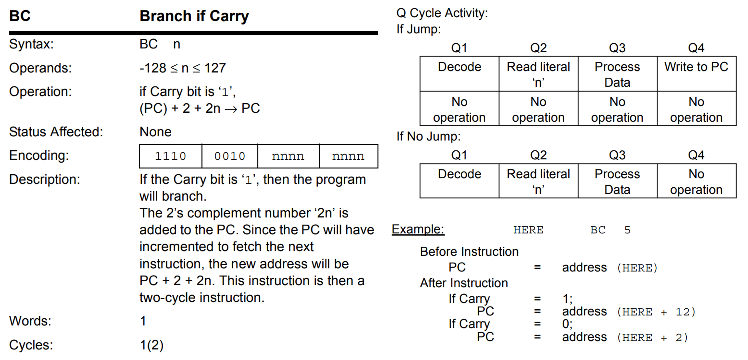
Control operations Cont.

Slide 22
Control operations Cont.
Unconditional Branch
BRA Branch Unconditionally
GOTO Go to Address 1st word 2nd word
Conditional Branch
BC Branch if Carry
BN Branch if Negative
BNC Branch if Not Carry
BNOV Branch if Not Overflow
BNZ Branch if Not Zero
BOV Branch if Overflow
BZ Branch if Zero

